Slide 1
CMPE 257 FINAL PROJECT Kickstarter Project Success Prediction INSTRUCTOR: Jahan Ghofraniha
TEAM MEMBERS: VIKAS TADEPU
SURYA TEJA GOUD PALLE
VINEETH REDDY THALASANI
Notes:
ID=d924773e-9a16-4d6d-9803-8cb819e99682 Recipe=text_billboard Type=TextOnly Variant=0 FamilyID=AccentBoxWalbaum_Zero

Slide 2

Contents
Outline
Problem Statement
Motivation
Methodology
Result

Slide 3
Outline

Slide 4
Objective: Develop a machine learning model to predict the success or failure of Kickstarter projects using launch information.
Methodology:
Literature review to identify key factors and effective ML models.
Data preprocessing: dropped highly correlated columns, performed PCA, and conducted feature engineering.
Model selection: Choose decision trees as the model of choice.
Training and evaluation: Trained the model on a dataset of 20,632 Kickstarter campaigns, achieving over 99% accuracy on a test set.
Results and Findings: The developed machine learning model based on decision trees demonstrated exceptional performance, achieving an accuracy of over 99% on a test set. This indicates the model's effectiveness in accurately predicting the success or failure of Kickstarter projects using only launch information. The project provides valuable insights into the factors influencing project outcomes, contributing to improved success rates and informed decision-making in the realm of Kickstarter crowdfunding.

Slide 5
Task Contribution:
Vikas Tadepu | Performed initial exploratory data analysis and trained the model on random forest as well as SVM algorithms. PCA was performed to transform the data into a lower-dimensional space. Assisted on the presentation slides.
Surya Teja Palle | Assisted with exploratory data analysis and worked on Logistic regression to train the model. Found the most suitable metric to evaluate the performance of the models and worked on the report.
Vineeth Reddy Thalasani | Assisted with exploratory data analysis and worked on training the model on Decision tree and created comparative analyses for all the algorithms. Also worked on the presentation slides and the report.

Slide 6
Problem Statement

Slide 7
Develop an accurate machine learning model that can predict the success or failure of Kickstarter projects using only information available at the time of project launch. This presents a unique challenge as predicting crowdfunding campaign outcomes involves various influencing factors.
We have access to a limited set of information at project launch, such as the funding goal, project category, and project duration. Therefore, the main challenge is to identify the most important features predictive of project success or failure based on this limited set of information.
We aim to help Kickstarter creators and investors make more informed decisions about which projects to invest in, ultimately increasing the success rate of projects on the platform.

Slide 8
Motivation

Slide 9
The motivation for this project is to help Kickstarter creators and backers make more informed decisions about their campaign strategies and investments, respectively.
For creators, the success of their projects can greatly impact their careers, income, and ability to pursue their creative passions. By accurately predicting the success of their campaign, creators can better plan their marketing and funding strategies, and avoid wasting time and resources on campaigns that are unlikely to succeed.
For backers, investing in a Kickstarter campaign is not only a financial decision but also an emotional one, as backers often support projects that align with their interests, beliefs, and values. By using a predictive model to identify promising projects, backers can make more informed decisions and increase their chances of backing successful projects that will deliver on their promised rewards.
Overall, the motivation for this project is to help maximize the potential of the Kickstarter platform, by improving the success rate of campaigns and fostering a more productive and rewarding ecosystem for creators and backers alike.

Slide 10
Methodology

Slide 11
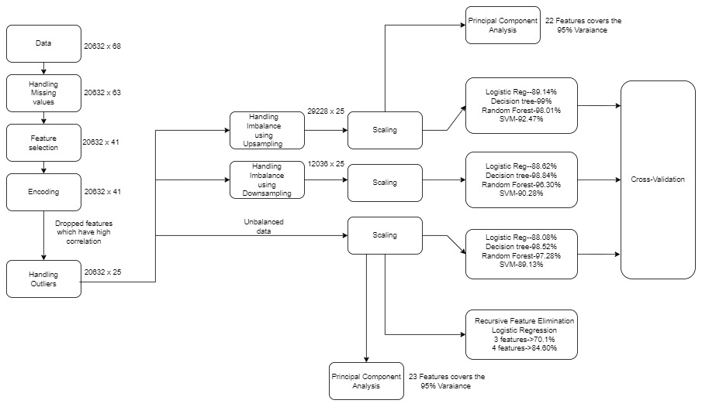
Flowchart of Methodology

Slide 12
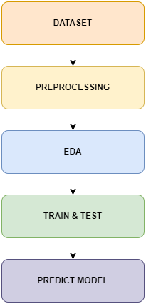
This dataset contains data on 20,632 Kickstarter campaigns on the site as of February 1st 2017.
The data will be processed by removing null and duplicate values, managing missing values, identifying and removing outliers, and transforming the data using techniques such as normalization and encoding. This will ensure our machine learning model is trained on accurate and reliable data for accurate predictions about the success or failure of Kickstarter projects.
Analyze data patterns using graphics like box plotting, bar plot, pie chart, etc. Check the meaning of the feature and obtain the required information.
Train data with different ML techniques and use Hyperparameter Data tuning. Check the accuracy and measurements of test data.
Here, we use our model to predict whether the project proposals will succeed or fail to achieve its fundraising objective by applying the required project launch information metrics.

Slide 13
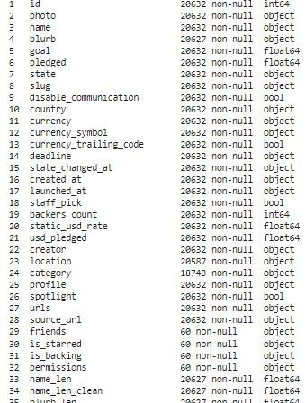
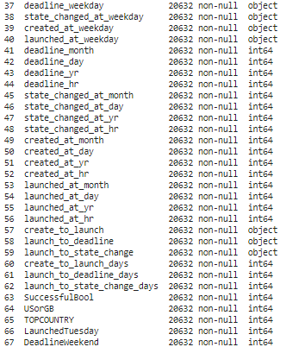
Dataset
The Dataset consists of 67 features:

Slide 14
Dropping off some of the features:
Unnamed
Friends
is_starred
is_backing
permissions
Reason: The data in the above features has not enough information for the machine learning model to learn from, which can lead to overfitting or underfitting of the model. So we decided to drop this features.

Slide 15
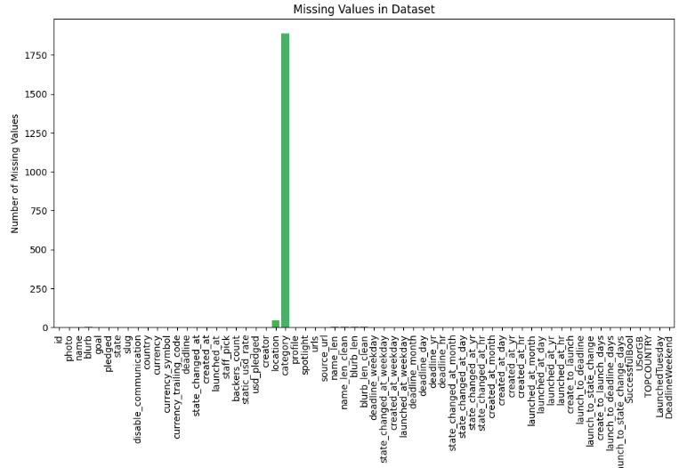
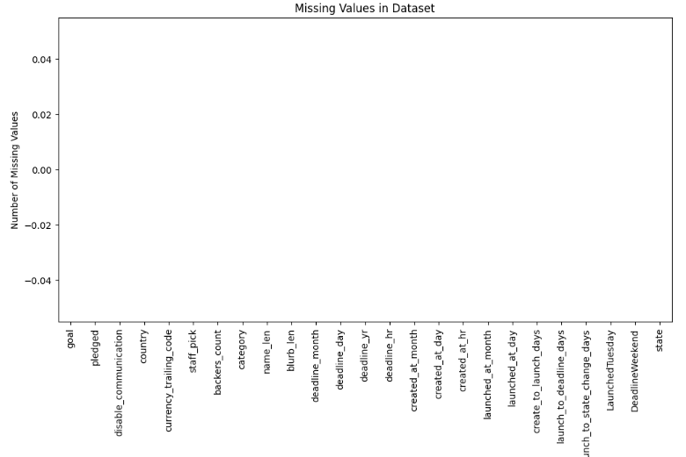
Data Preprocessing
Dealing with missing values:

Slide 16
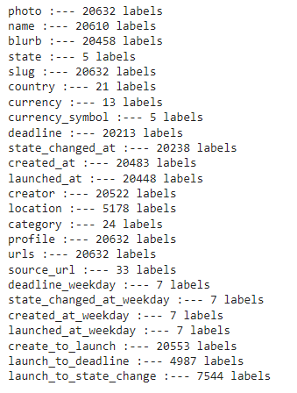
Checking unique values for categorical columns:
Unique values in the model can increase the model's complexity, leading to overfitting, and reduced accuracy. So we decided to remove the unique values in categorical columns, to simplify the data and reduce the model's complexity, making it easier for the model to learn the underlying patterns in the data, and improve its overall performance.

Slide 17
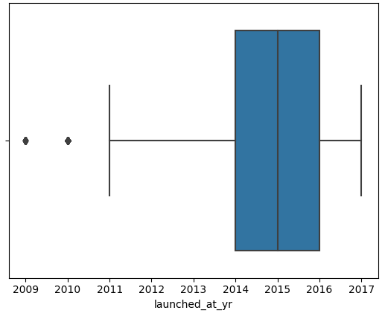
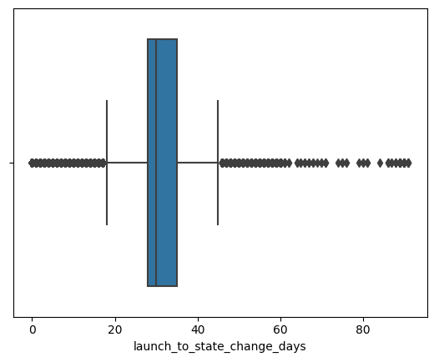
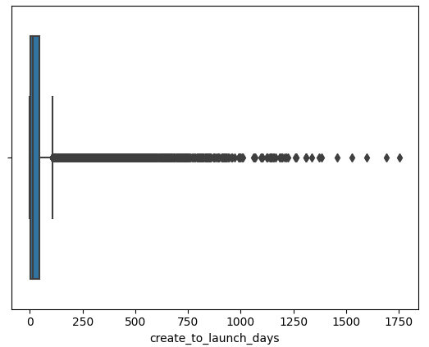
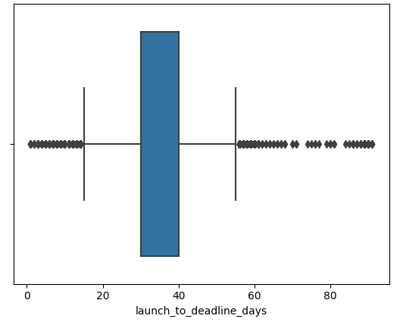
Handling the outliers:

Slide 18
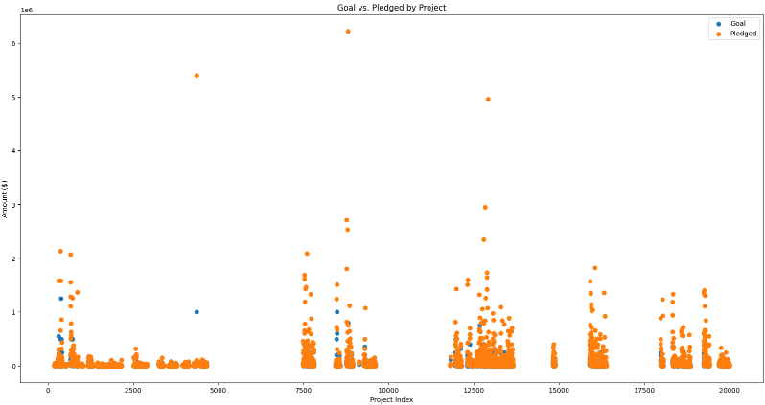
It is obvious that a project is labelled as successful if amount pledged ≥ goal and unsuccessful if amount pledged < goal. The following graph visualizes both the goal and amount pledged for each project and the individual state of the project

Slide 19
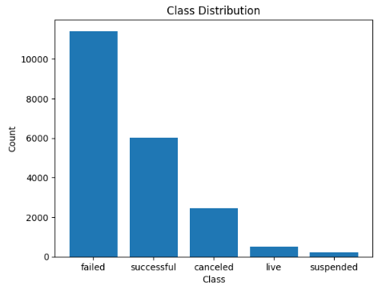
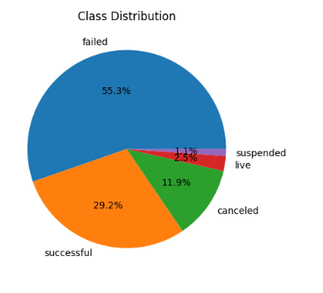
Class distribution of State feature: (unbalanced data)

Slide 20
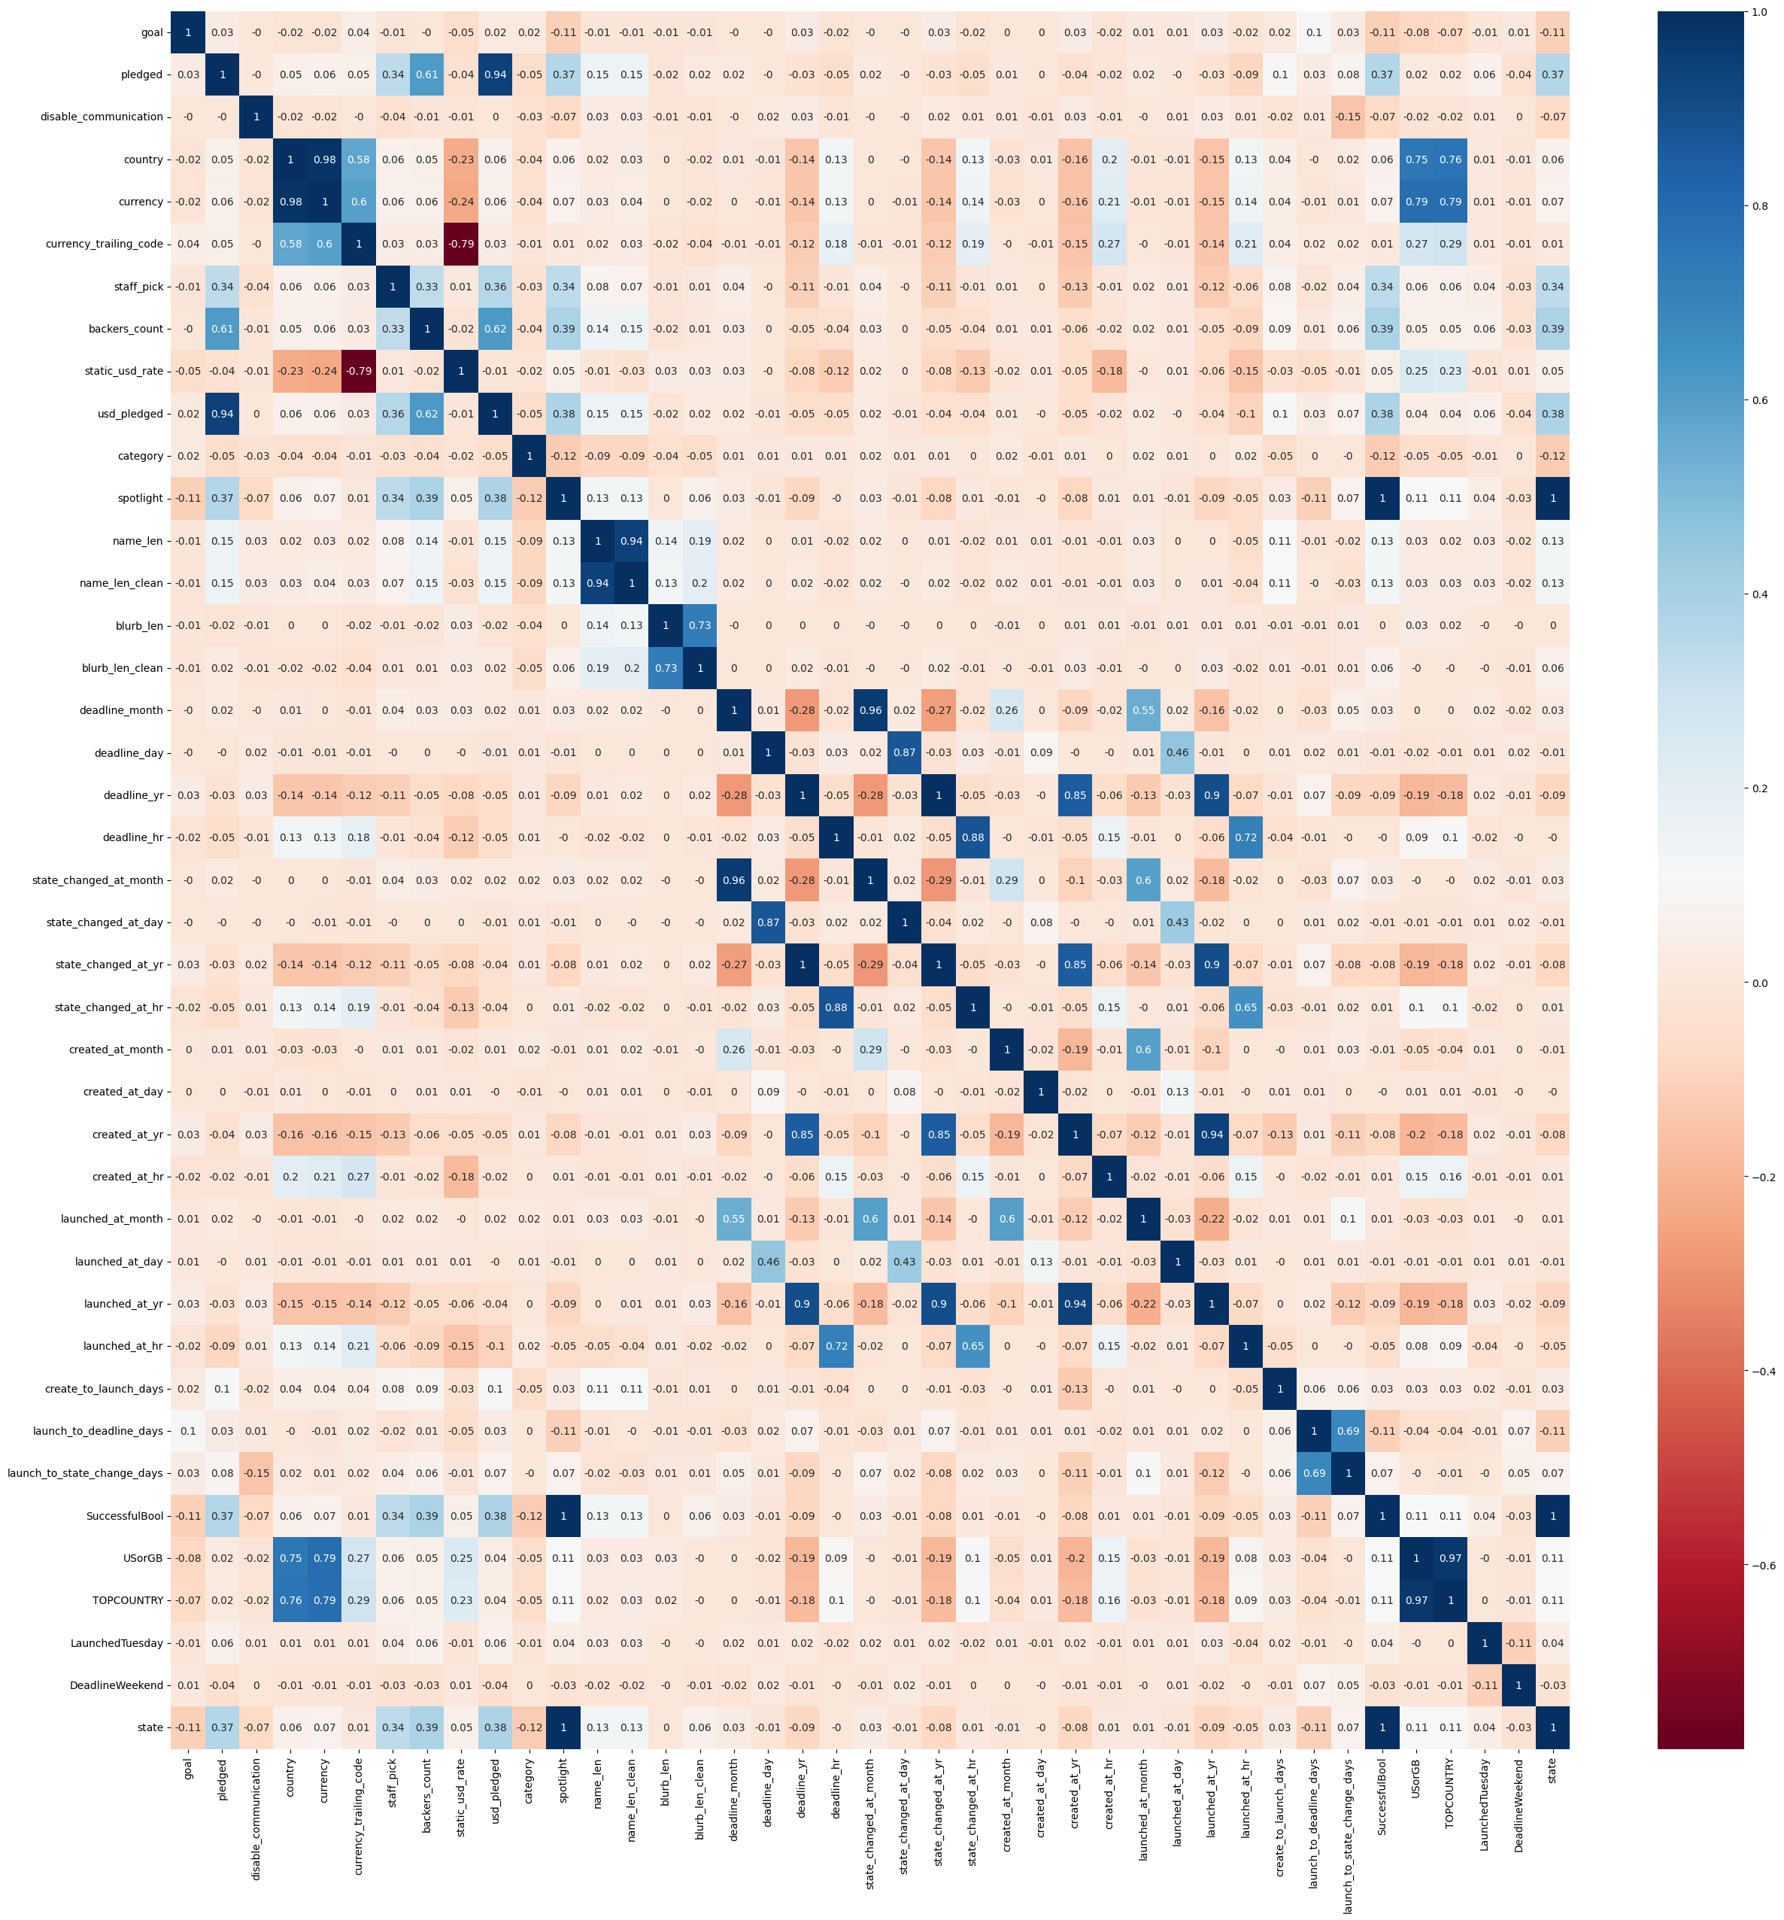
Correlation Matrix:
Dropped the features above a threshold of 0.7 in a correlation matrix to reduce the dimensionality of data and prevent multicollinearity.

Slide 21
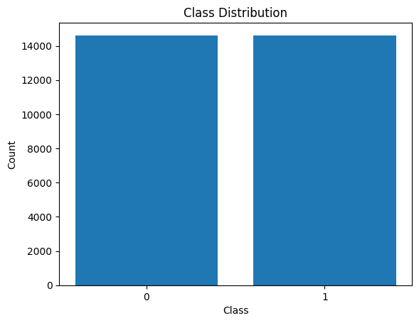
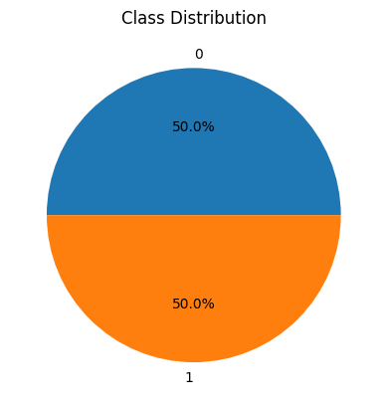
Class distribution of State feature: (balanced data)
We have used to label encoding for class distribution of state feature.

Slide 22
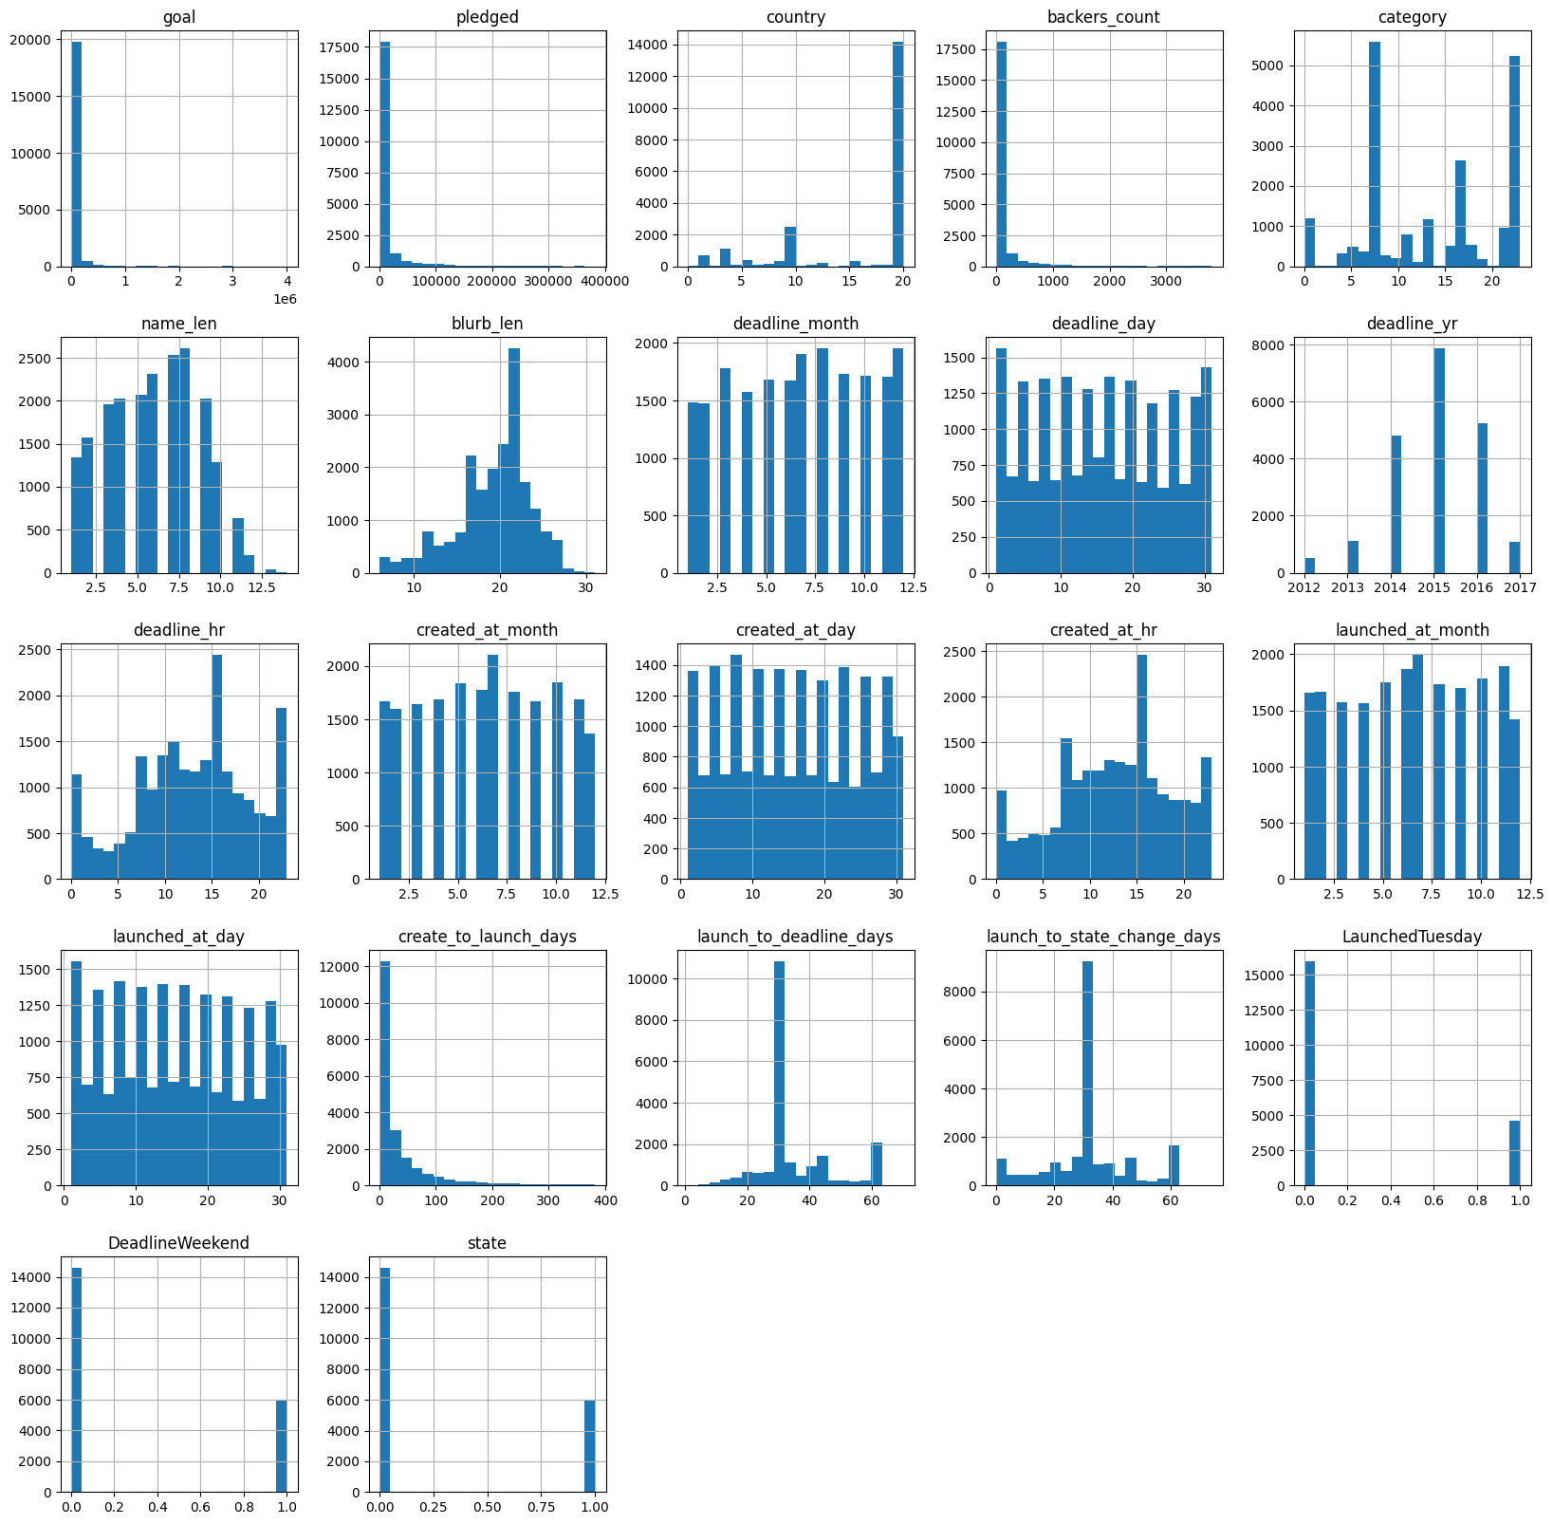
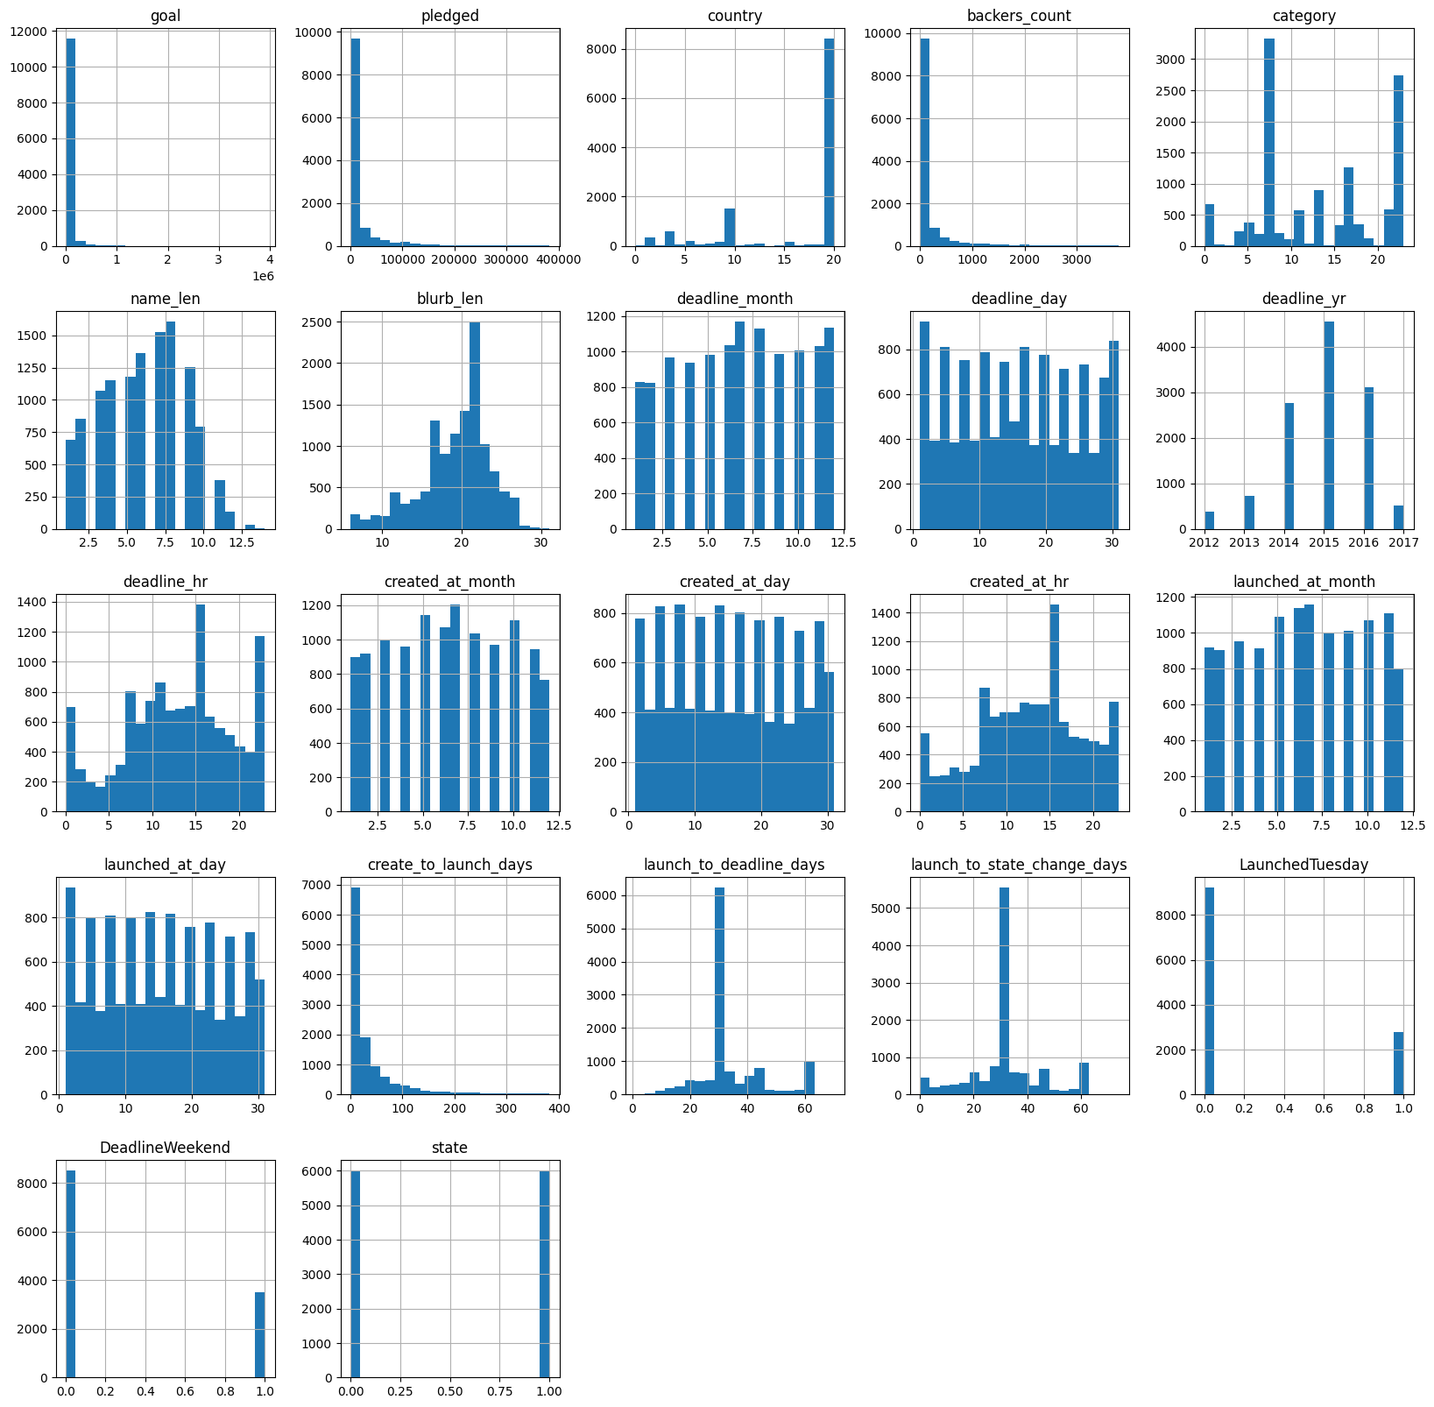
Data before and after Sampling:

Slide 23
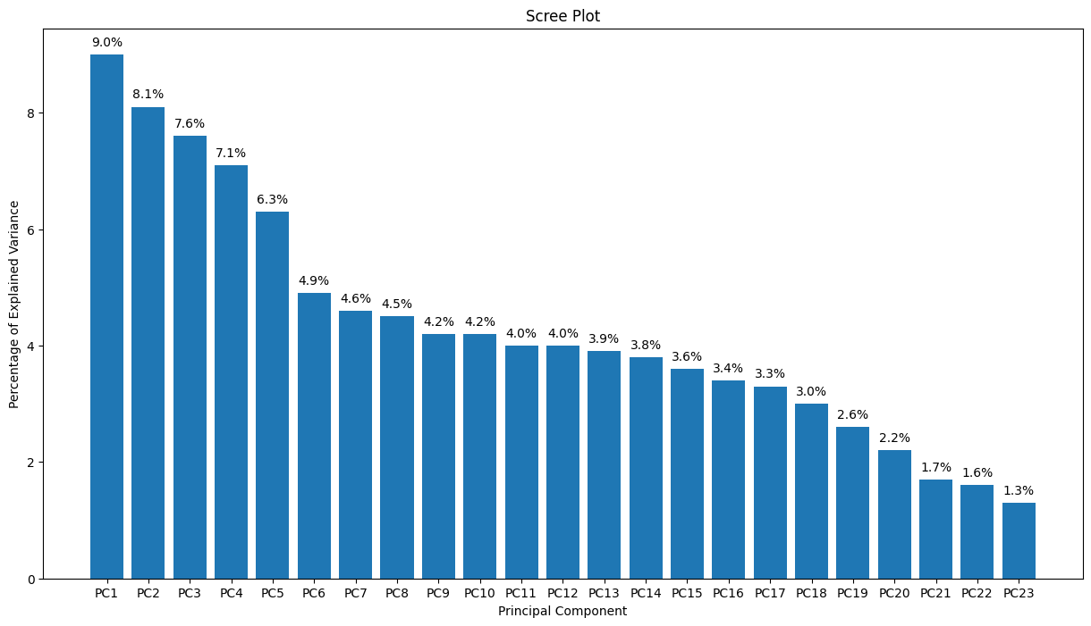
PCA for Unbalanced Data:

Slide 24
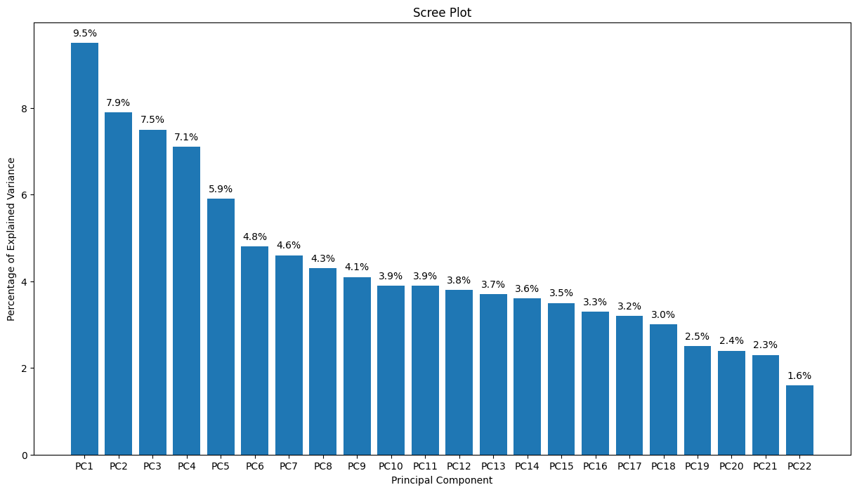
PCA for Upsampled Data:

Slide 25
Models
Logistic Regression:
For Unbalanced Data:
Test Accuracy: 0.8807850739035619
Train Accuracy: 0.8807850739035619
For Upsampled Data:
Test Accuracy: 0.8913787204926445
Train Accuracy: 0.8805919083055341
For Downsampled Data:
Test Accuracy: 0.8862126245847176
Train Accuracy: 0.881699210635646
Logistic Regression with RFE:
For Unbalanced Data:
Num Features: 3
Model Score with selected features is: 0.8110715752018612
Num Features: 4
Model Score with selected features is: 0.879567537977282

Slide 26
SVM:
For Unbalanced Data:
Best parameters: {'C': 10, 'gamma': 'auto', 'kernel': 'rbf’}
Best score: 0.8813181913629787
Accuracy score: 0.892730210016155
For Up-Sampled Data:
Best parameters: {'C': 10, 'gamma': 'scale', 'kernel': 'rbf'}
Best score: 0.9187836093596735
Accuracy score: 0.9247348614437222
For Down-Sampled Data:
Best parameters: {'C': 10, 'gamma': 0.1, 'kernel': 'linear'}
Best score: 0.8950977869482543
Accuracy score: 0.9028239202657807

Slide 27
Random Forest:
For Unbalanced Data:
Best parameters: {'max_depth': None, 'min_samples_leaf': 1, 'min_samples_split': 5, 'n_estimators': 200}
Best score: 0.9727961223871553
Accuracy: 0.9757693239641386
For Upsampled Data:
Best parameters: {'max_depth': None, 'min_samples_leaf': 1, 'min_samples_split': 2, 'n_estimators': 200}
Best score: 0.9801556604558683
Accuracy: 0.9801573725624358
For Downsampled Data:
Best parameters: {'max_depth': None, 'min_samples_leaf': 1, 'min_samples_split': 2, 'n_estimators': 200}
Best score: 0.9630241534166769
Accuracy: 0.9613787375415282

Slide 28
Decision Trees:
For Unbalanced Data:
Best parameters found:{'criterion': 'entropy', 'max_depth': 10, 'min_samples_leaf': 1, 'min_samples_split': 2}
Accuracy: 0.9852192876181245
For Upsampled Data:
Best parameters found:{'criterion': 'entropy', 'max_depth': 20, 'min_samples_leaf': 1, 'min_samples_split': 2}
Accuracy: 0.9923024290112897
For Downsampled Data:
Best parameters found:{'criterion': 'gini', 'max_depth': 10, 'min_samples_leaf': 2, 'min_samples_split': 10}
Accuracy: 0.9883720930232558

Slide 29
Results

Slide 30
Results:
Logistic Regression: Achieving an accuracy of 0.8913, logistic regression demonstrated a strong performance in predicting project success. This model utilizes a linear decision boundary and probabilistic framework to classify projects.
Decision Trees: Outperforming other models, decision trees exhibited an impressive accuracy of 0.9923. Decision trees partition the feature space based on a series of if-else conditions, enabling them to capture complex patterns and relationships within the data.
Random Forest: With an accuracy of 0.9801, random forest demonstrated robust predictive capabilities. It combines multiple decision trees through ensemble learning, resulting in improved generalization and reduced overfitting.
Support Vector Machines (SVM): SVM achieved an accuracy of 0.8927, making it a competitive model for Kickstarter project success prediction. SVM constructs a hyperplane that maximally separates the classes in the feature space, leveraging both linear and nonlinear kernels.

Slide 31
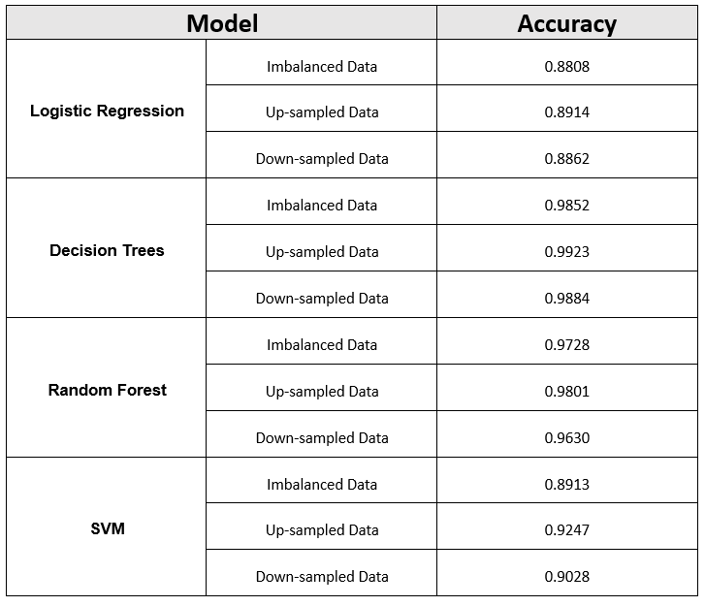
Model Accuracy:
Comparing the accuracies of each model

Slide 32
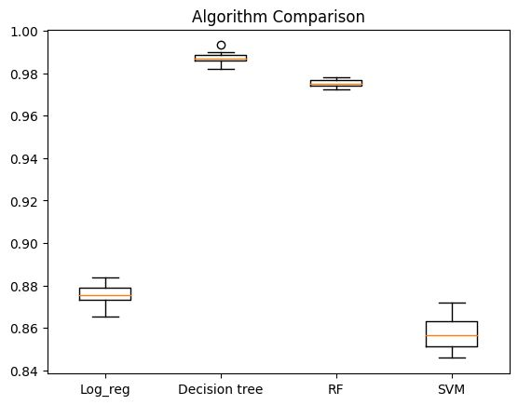
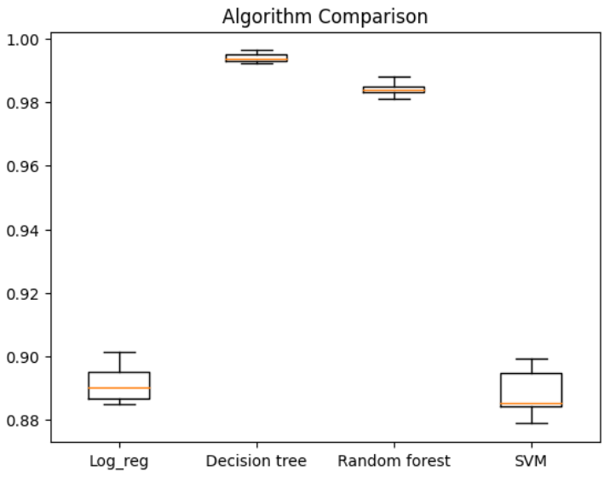
Cross-Validation of models on Unbalanced data
Cross-Validation of models on Balanced data
Overall, The Decision Tree Algorithm on unsampled data worked best for us and feature selection and performing Principal Component Analysis was proven helpful.

Slide 33
THANK YOU

